Slide 1
第6-1章: Microarray and Expression Measurements
Introduction to Microarray
Expression measurements

Slide 2
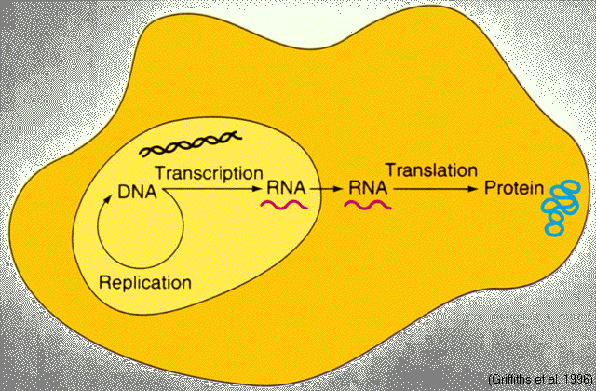
Transcriptome

Slide 3
Gene Expression
Each cell contains a complete set of DNA.
Only a fraction of these are used (or “expressed”) in any particular cell at any given time. For example, genes specific for erythroid cells, such as the hemoglobin genes, are not expressed in brain cells.

Slide 4
What is a DNA Microarray?
Also known as DNA Chip
Allows simultaneous measurement of the level of transcription for every gene in a genome (gene expression)
Transcription?
Process of copying of DNA into messenger RNA (mRNA)
Environment dependent!
Microarray detects mRNA, or rather the more stable cDNA

Slide 5
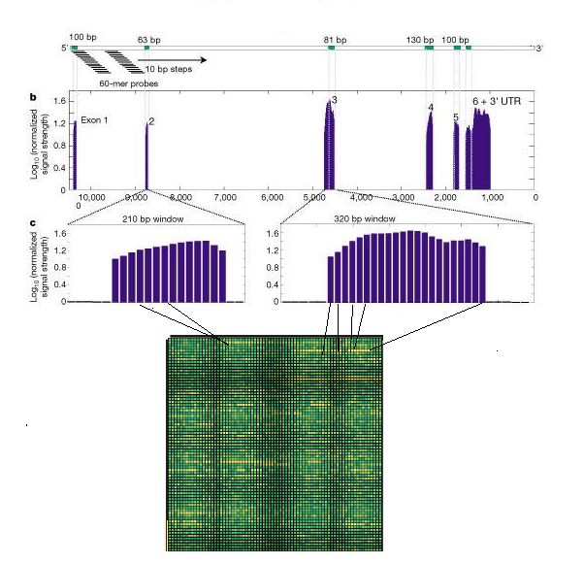
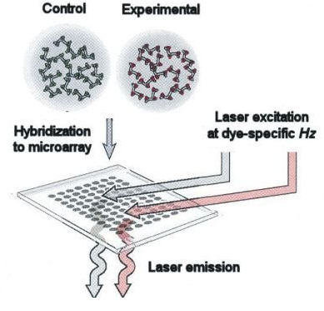
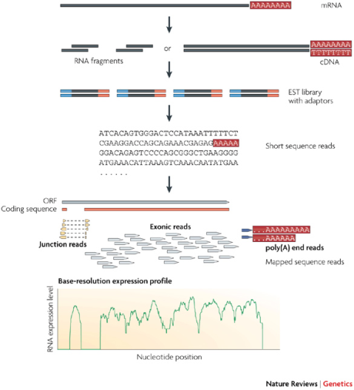
The Evolution of Transcriptomics
Hybridization-based
RNA-seq is still a technology under active development
1995 P. Brown, et. al.
Gene expression profiling
using spotted cDNA microarray: expression levels of known genes
2002 Affymetrix, whole genome expression profiling using tiling array: identifying and profiling novel genes and splicing variants
2008 many groups, mRNA-seq: direct sequencing of mRNAs using next generation sequencing techniques (NGS)

Slide 6
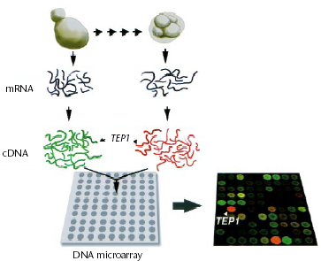
cDNA Microarray
Brown & Botstein, 1999

Slide 7
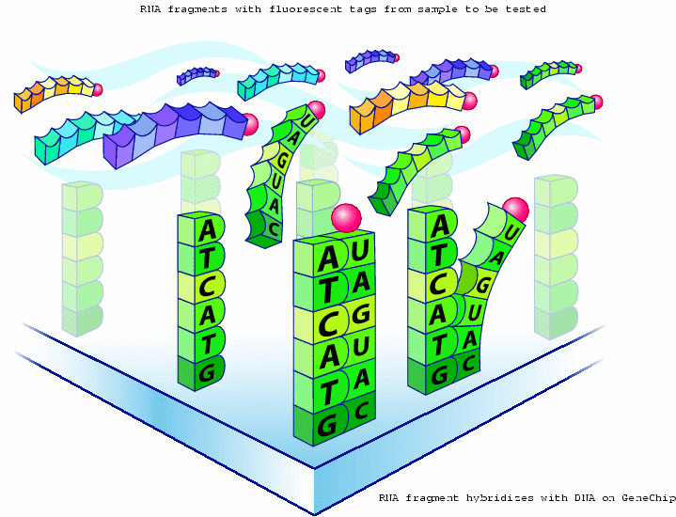
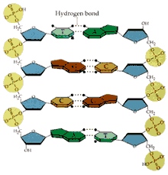
杂交机制(hybridization)->生物芯片

Slide 8
生物学芯片

Slide 9
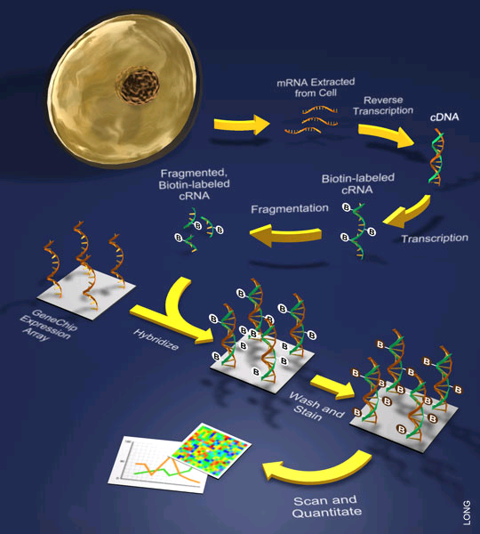
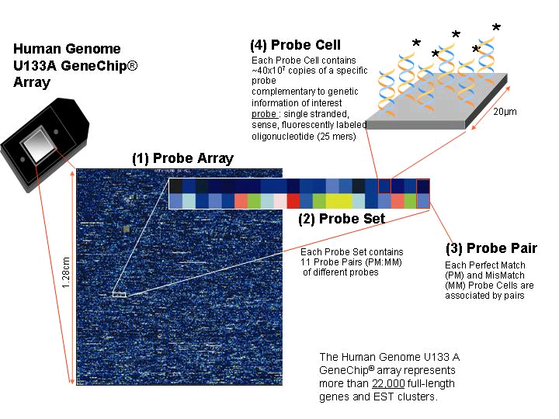
Affymetrix 表达芯片

Slide 10
Glossary
Probe: gene specific oligonucleotides
20 - 25 bases in each probe, i.e., 20-25 mer
Perfect match (PM)
Miss match (MM)
Probe pair: a (PM, MM) pair
Probe-pair set: a collection of probe-pairs (usually 20) represent each gene
“20 digit barcode”

Slide 11
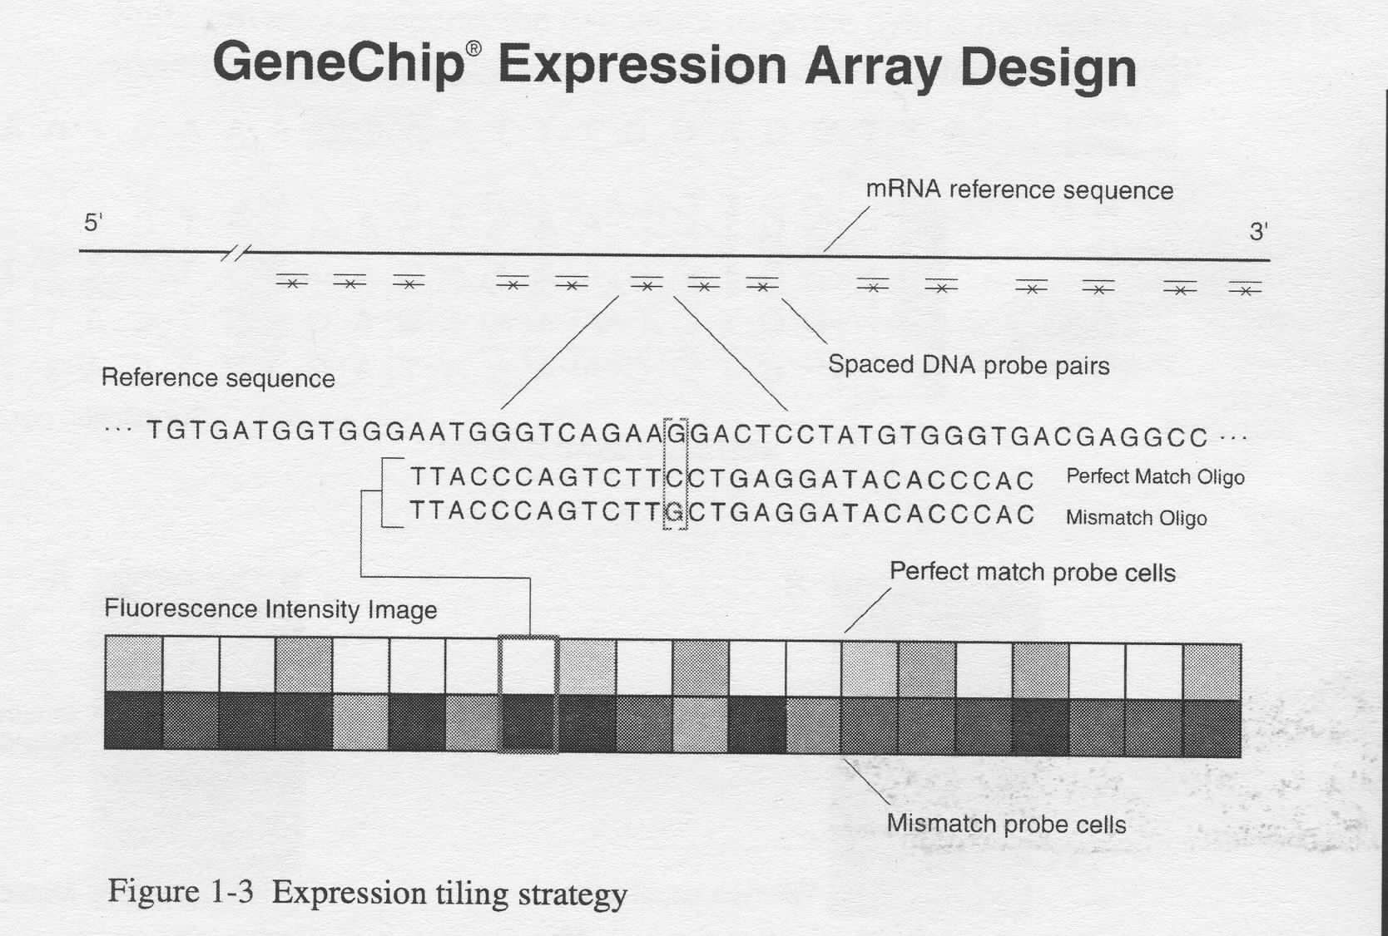

Slide 12

How RNA-seq works
Sample preparation
Next generation sequencing (NGS)
Data analysis:
Mapping reads
Visualization (Gbrowser)
De novo assembly
Quantification
Figure from Wang et. al, RNA-Seq: a revolutionary tool for transcriptomics, Nat. Rev. Genetics 10, 57-63, 2009).

Slide 13
FPKM (RPKM): Expression Values
Fragments Reads Per Kilobase of exon model per Million mapped fragments
Nat Methods. 2008, Mapping and quantifying mammalian transcriptomes by RNA-Seq. Mortazavi A et al.
C= the number of reads mapped onto the gene's exons
N= total number of reads in the experiment
L= the sum of the exons in base pairs.

Slide 14
Part I: Expression Measurement
MEBI
PDNN
References
Cheng Li, Wing H. Wong. Model-based analysis of oligonucleotide arrays Expression index computation and outlier detection. PNAS 98:31-36, 2001.
Zhang L, Miles MF, Aldape KD. A model of molecular interactions on short oligonucleotide microarrays. Nat Biotechnology 21(7):818-821, 2003.

Slide 15
Expression Measurement
Affymetrix average approach
Model Based Expression Index approach (Li & Wong)
Robust Multi-Array approach (Irizarry & Speed)
Position dependent nearest neighbor model (Zhang et al)

Slide 16
Data and Notation
Probe intensity in chip i, probe j, and gene n
i=1,…I (ranging from 1 to hundreds)
j=1,…, J (usually 16 or 20)
n=1,…, N (between 8,000 to 12,000)

Slide 17
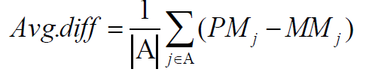
Affymetrix Average Approach
Affymetrix’s Genechip@ software use Avg.diff
where A is a set of suitable pairs chosen by the software

Slide 18
Affymetrix’s MAS5.0
Affymetrix’s new analysis approach
where MM* a version of MM that is never bigger than PM

Slide 19
dChip---MBEI Model Base Expression Index
Li-Wong full
with identifiablity constraint

Slide 20
dChip---MBEI Model-based Expression Index
Li-Wong reduced
with identifiability constraint

Slide 21
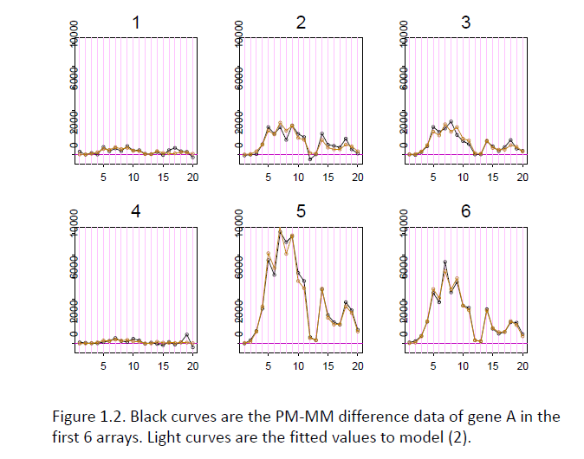

Slide 22
PDNN Model
The model is named Position Dependent Nearest Neighbour (PDNN)
The hybridization is characterized by a energy, and the energy is approximated by pair-wised interaction between nearest neighbours.

Slide 23
PDNN Model
Position Dependent Nearest Neighbor Model

Slide 24
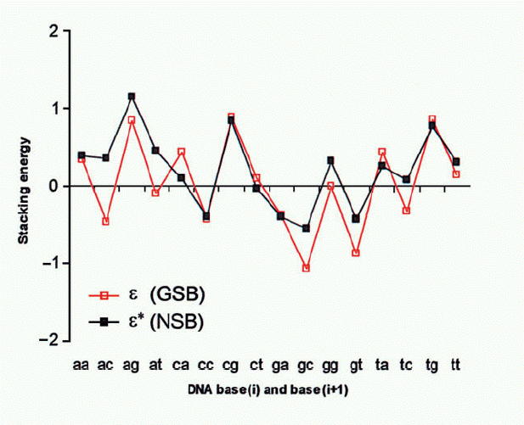
Stack Energy

Slide 25
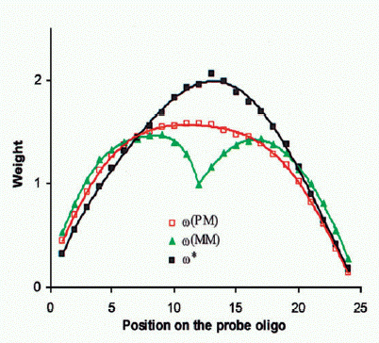
Positional Weights

Slide 26
Extension : Generalized PDNN Model in SNP Array
Wan L, Sun KL, Ding Q, Cui YH, Li M, Wen YL, Elston R, Qian MP and Fu WJ. Hybridization modeling of oligonucleotide SNP arrays for accurate DNA copy number estimation. Nucleic Acids Research, 37(17):e117.(2009)

Slide 27
Extension: Generalized PDNN Model in SNP Array
Wan L, Sun KL, Ding Q, Cui YH, Li M, Wen YL, Elston R, Qian MP and Fu WJ. Hybridization modeling of oligonucleotide SNP arrays for accurate DNA copy number estimation. Nucleic Acids Research, 37(17):e117.(2009)

Slide 28
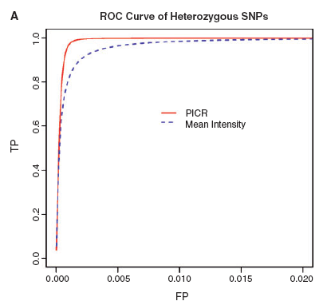
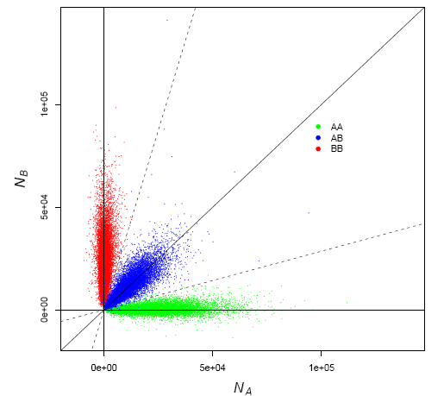
More Accurate Genotyping
Wan L, Sun KL, Ding Q, Cui YH, Li M, Wen YL, Elston R, Qian MP and Fu WJ. Hybridization modeling of oligonucleotide SNP arrays for accurate DNA copy number estimation. Nucleic Acids Research, 37(17):e117.(2009)

